Slide 1
Lecture 5:
2.1. Economic Growth’s Absence in the Malthusian Agrarian Age
Brad DeLong
Department of Economics and Blum Center, U.C. Berkeley; WCEG; and NBER
last revised: 2020-01–12
Original course by Melissa Dell (Harvard Econ 1342), revised by Brad DeLong, research assistance by Anish Biligiri
<https://github.com/braddelong/public-files/blob/master/econ-135-lecture-5.pptx>

Slide 2
Roadmap for the Next Week
5. MAA:
Read Before: Jared Diamond (1997): The Worst Mistake in the History of the Human Race <https://www.discovermagazine.com/planet-earth/the-worst-mistake-in-the-history-of-the-human-race>
Read Before: The Man Who Saw the Deep (Gilgamesh), selections <https://delong.typepad.com/files/gilgamesh-selections.pdf>
Slides: <https://github.com/braddelong/public-files/blob/master/econ-135-lecture-5.pptx>
Assignment: Malthusian economies paper <https://bcourses.berkeley.edu/courses/1487685/assignments/8065917>
6. Civilizational "Efflorescences" and Imperial Declines:
Read Before: Willem M. Jongman (2007): Gibbon was Right: The Decline and Fall of the Roman Economy <https://delong.typepad.com/jongman-gibbon-was-right.pdf>
Read Before: Peter Temin: The Roman Market Economy, Roman Growth <https://delong.typepad.com/files/temin-roman-growth.pdf>
Finish: Assignment 4: Malthusian economies paper; due Feb 12
7. Why Was Pre-Industrial Progress so Slow on Average?:
Read Before: Josh Ober (2019): Agamemnon's Cluelessness, selections <https://delong.typepad.com/files/ober-agamemnon-selections.pdf>
Read Before: Moses Finley: Technical Innovation and Economic Progress in the Ancient World <https://delong.typepad.com/finley-technical.pdf> (Links to an external site.) Start: Assignment 5: Simulations with the Solow growth model; due Feb 19

Slide 3
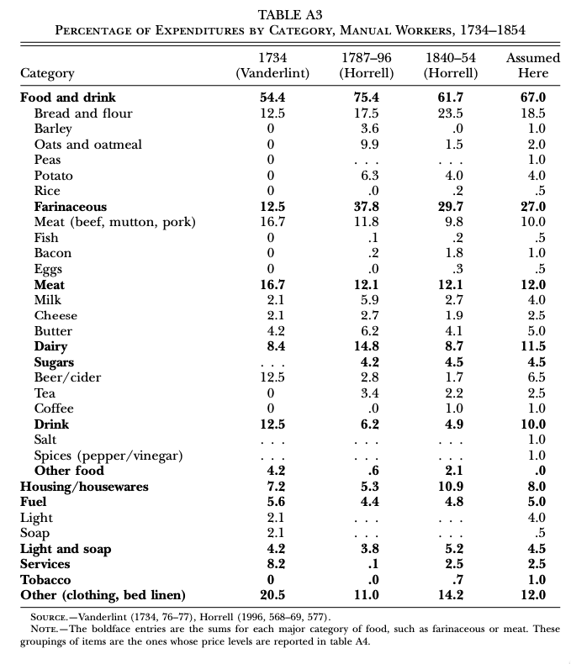
“Subsistence”
From Clark: Condition of Working Class in England
"Manual workers”—70% of median, 50% of average
70% spent on food
30-40% grains
20% meat and dairy
This is a very rich pre-industrial population

Slide 4
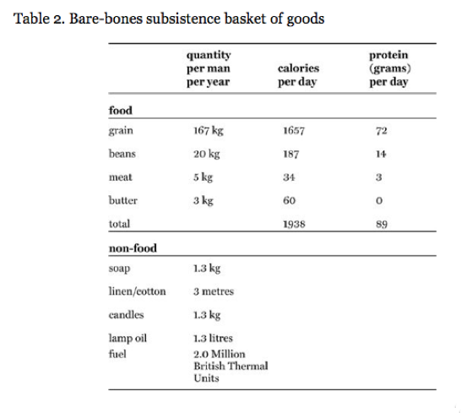
“Bare-Bones”

Slide 5
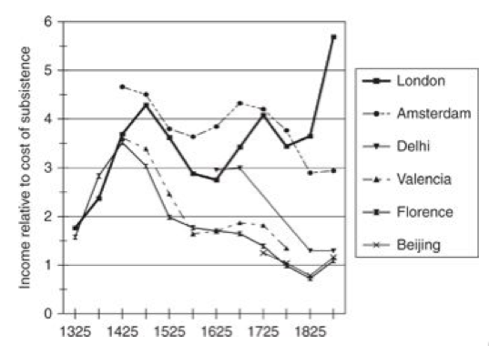
Cities

Slide 6
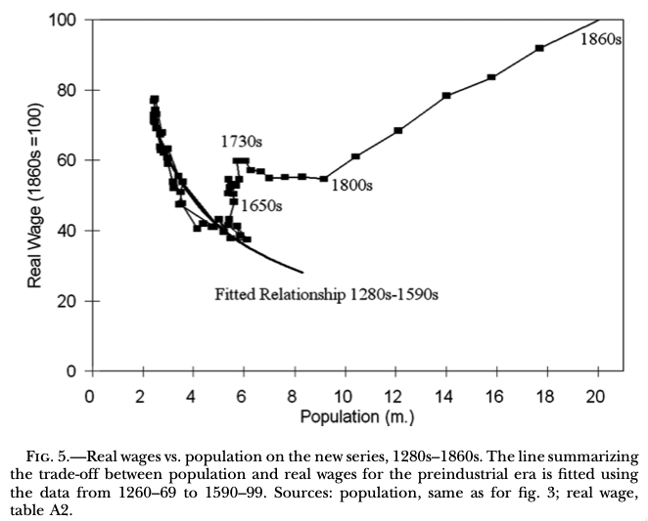
Escape

Slide 7
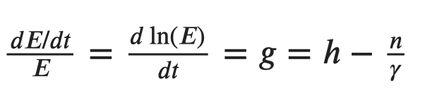

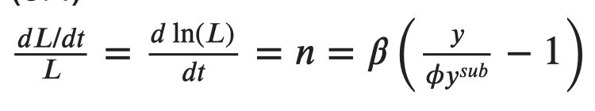
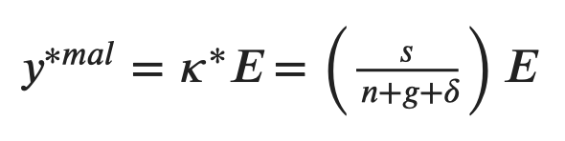

Malthusian Models

Slide 8
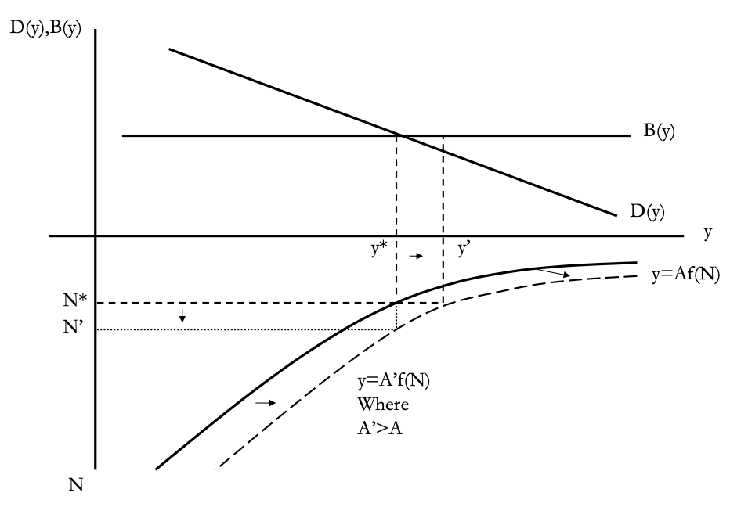
Perhaps Diagrams Are More Intuitive?
Income per-capita always returns to the point where the birth rate is just enough above the death rate to deliver population growth that soaks up technological improvement:
This is the unique attracting steady-state of the model.
What happens if there is a one-time permanent jump up in H that improves technology from A to A′ > A?
This means more output for any level of population.
The initial level of population N∗ now produces an income level y’ > y*.
This leads to higher incomes and an excess of births over deaths since B > D(y′).
In consequence, the population expands from N∗ to N′ until income per-capita is driven back down to where it was before.
􏰀The same is true for other changes which have similar implications for the relationship between population and income, for instance good government.
Slide taken from Melissa Dell

Slide 9
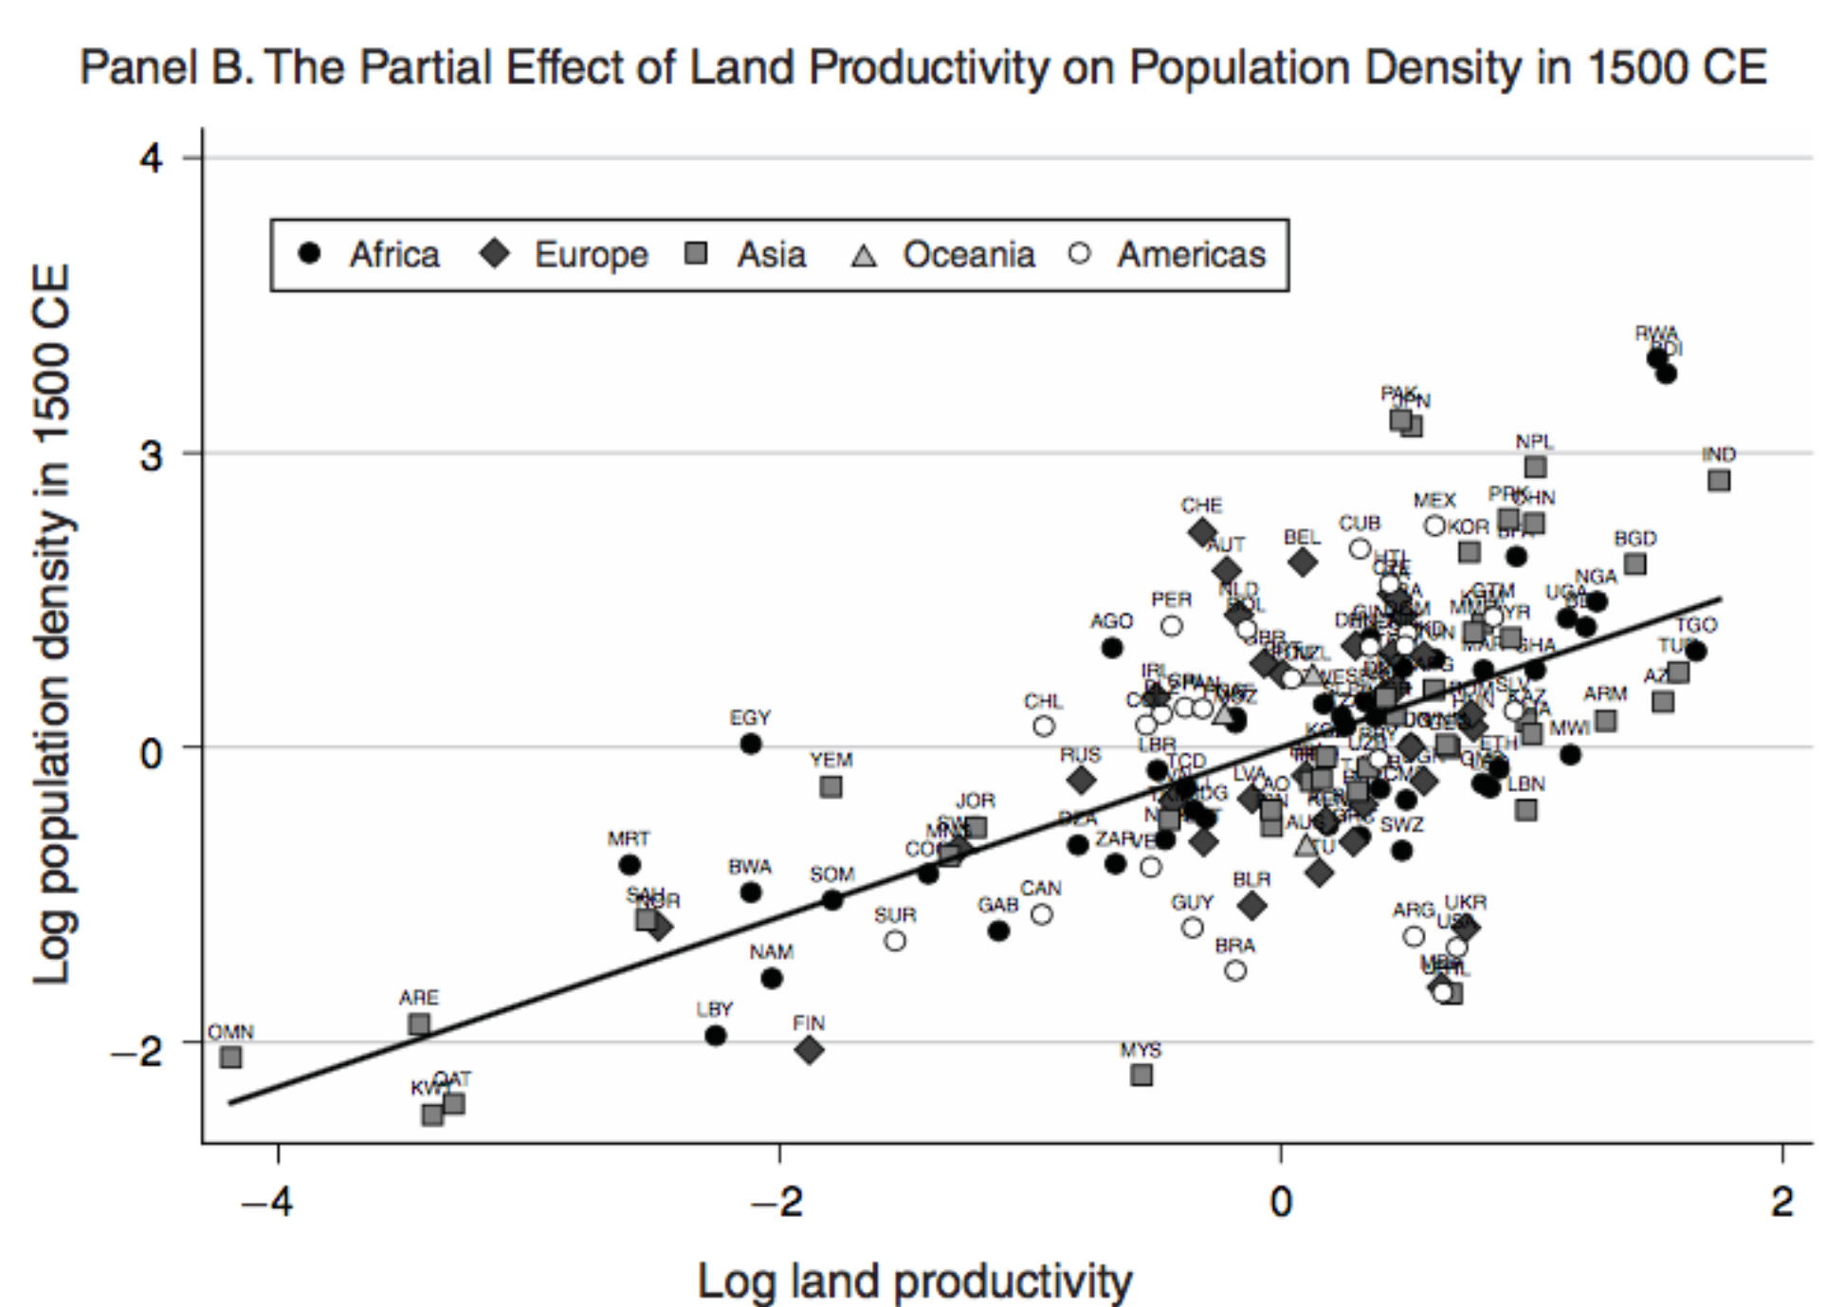
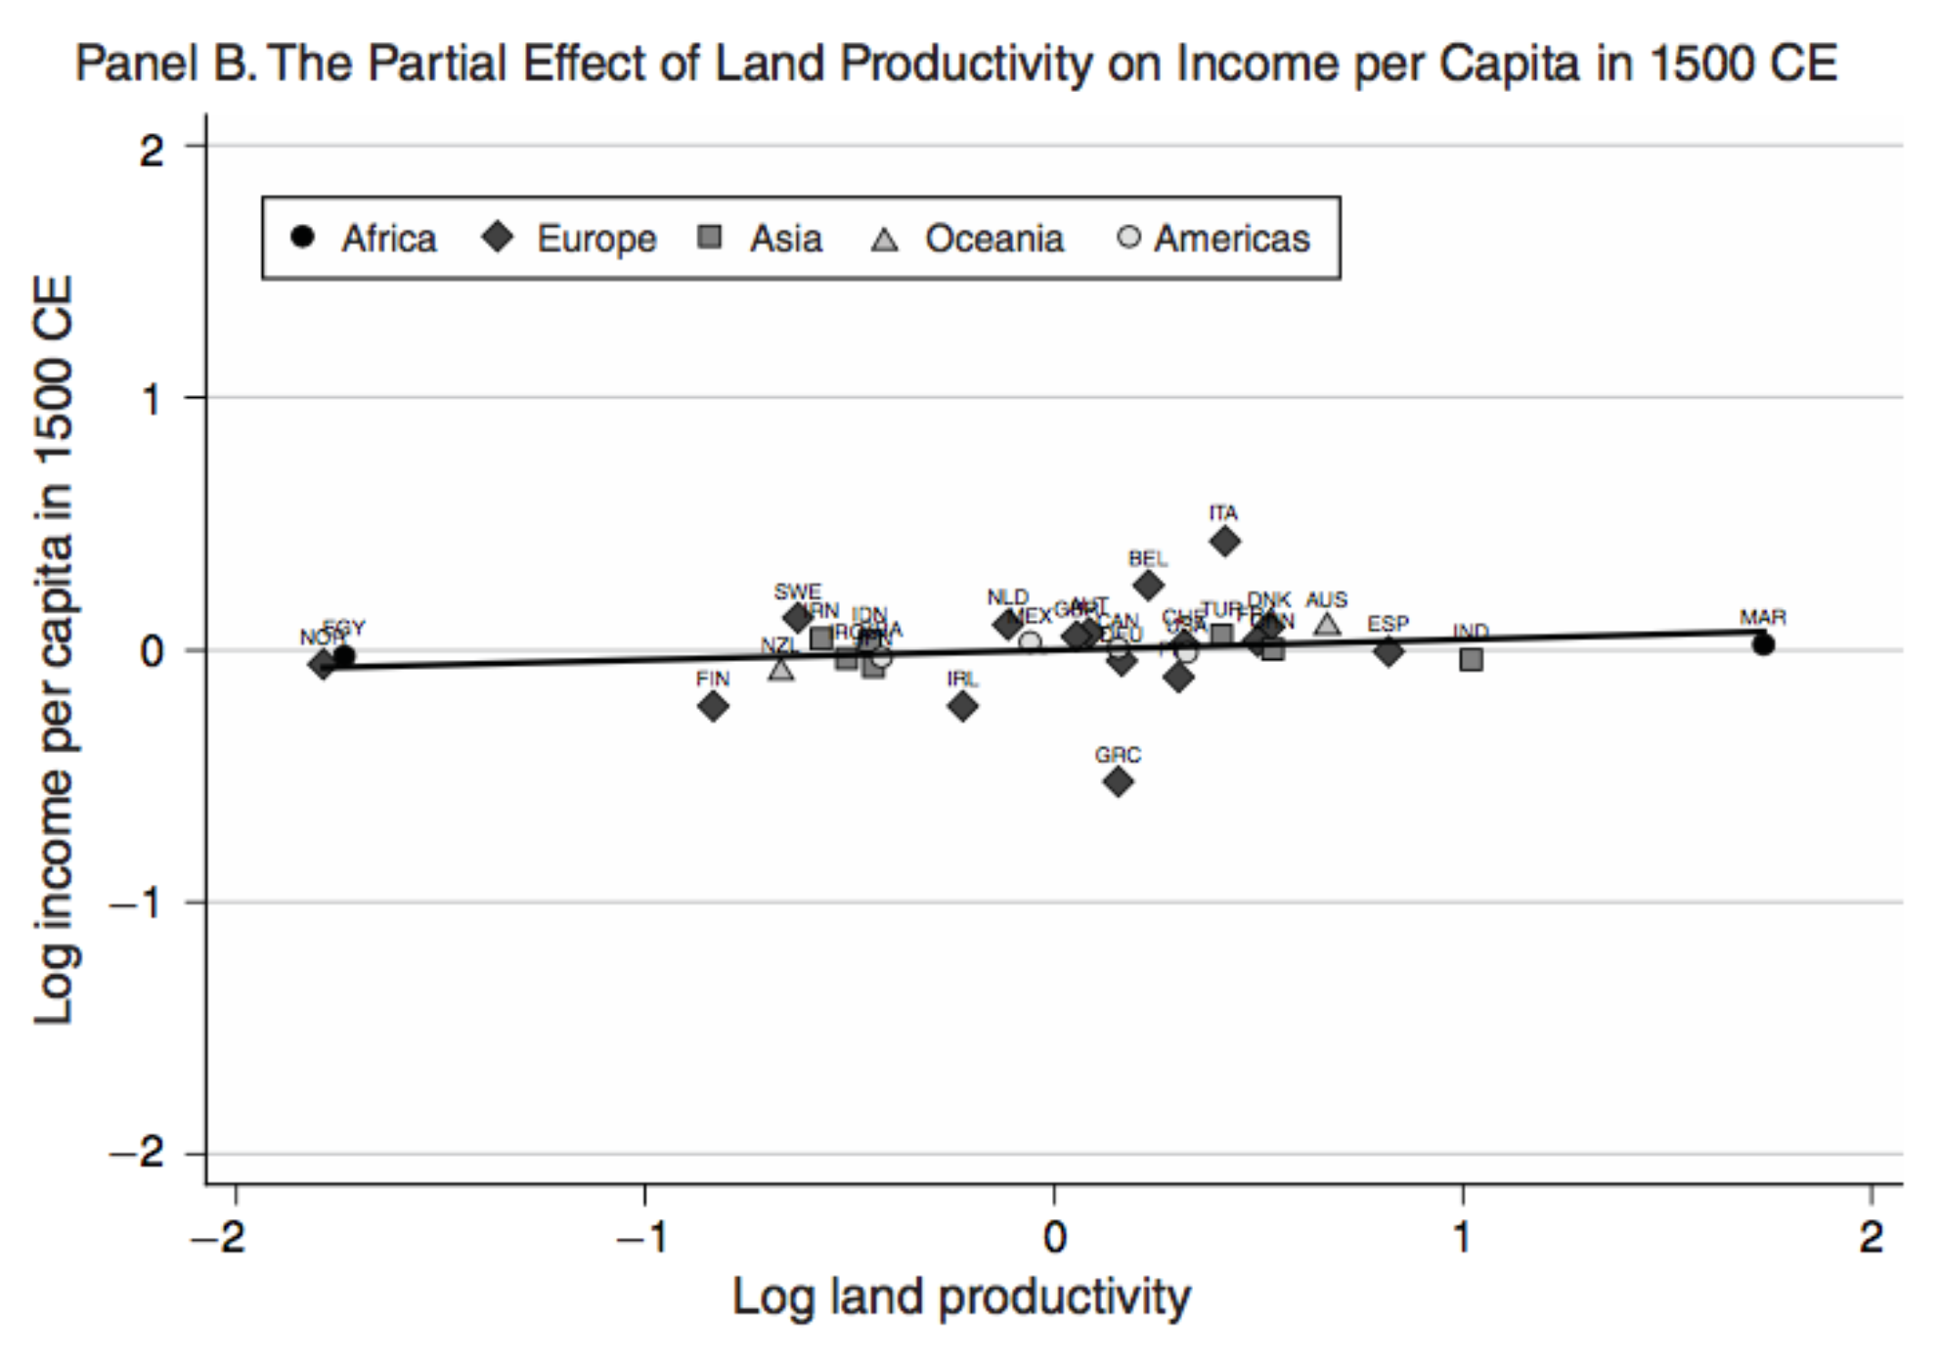
Is Malthus Right?
At the macro level, yes; but there are lots of interesting meso- and small-scale puzzles:
Malthusian model implies that even though the Spanish might have had better technology than the Inca, there income per-capita ought to have differed only according to their fertility and mortality schedules.
But population density in the pre-modern era is positively correlated with proxies for per-capita income, such as urbanization or Maddison’s income estimates.
Slide taken from Melissa Dell

Slide 10
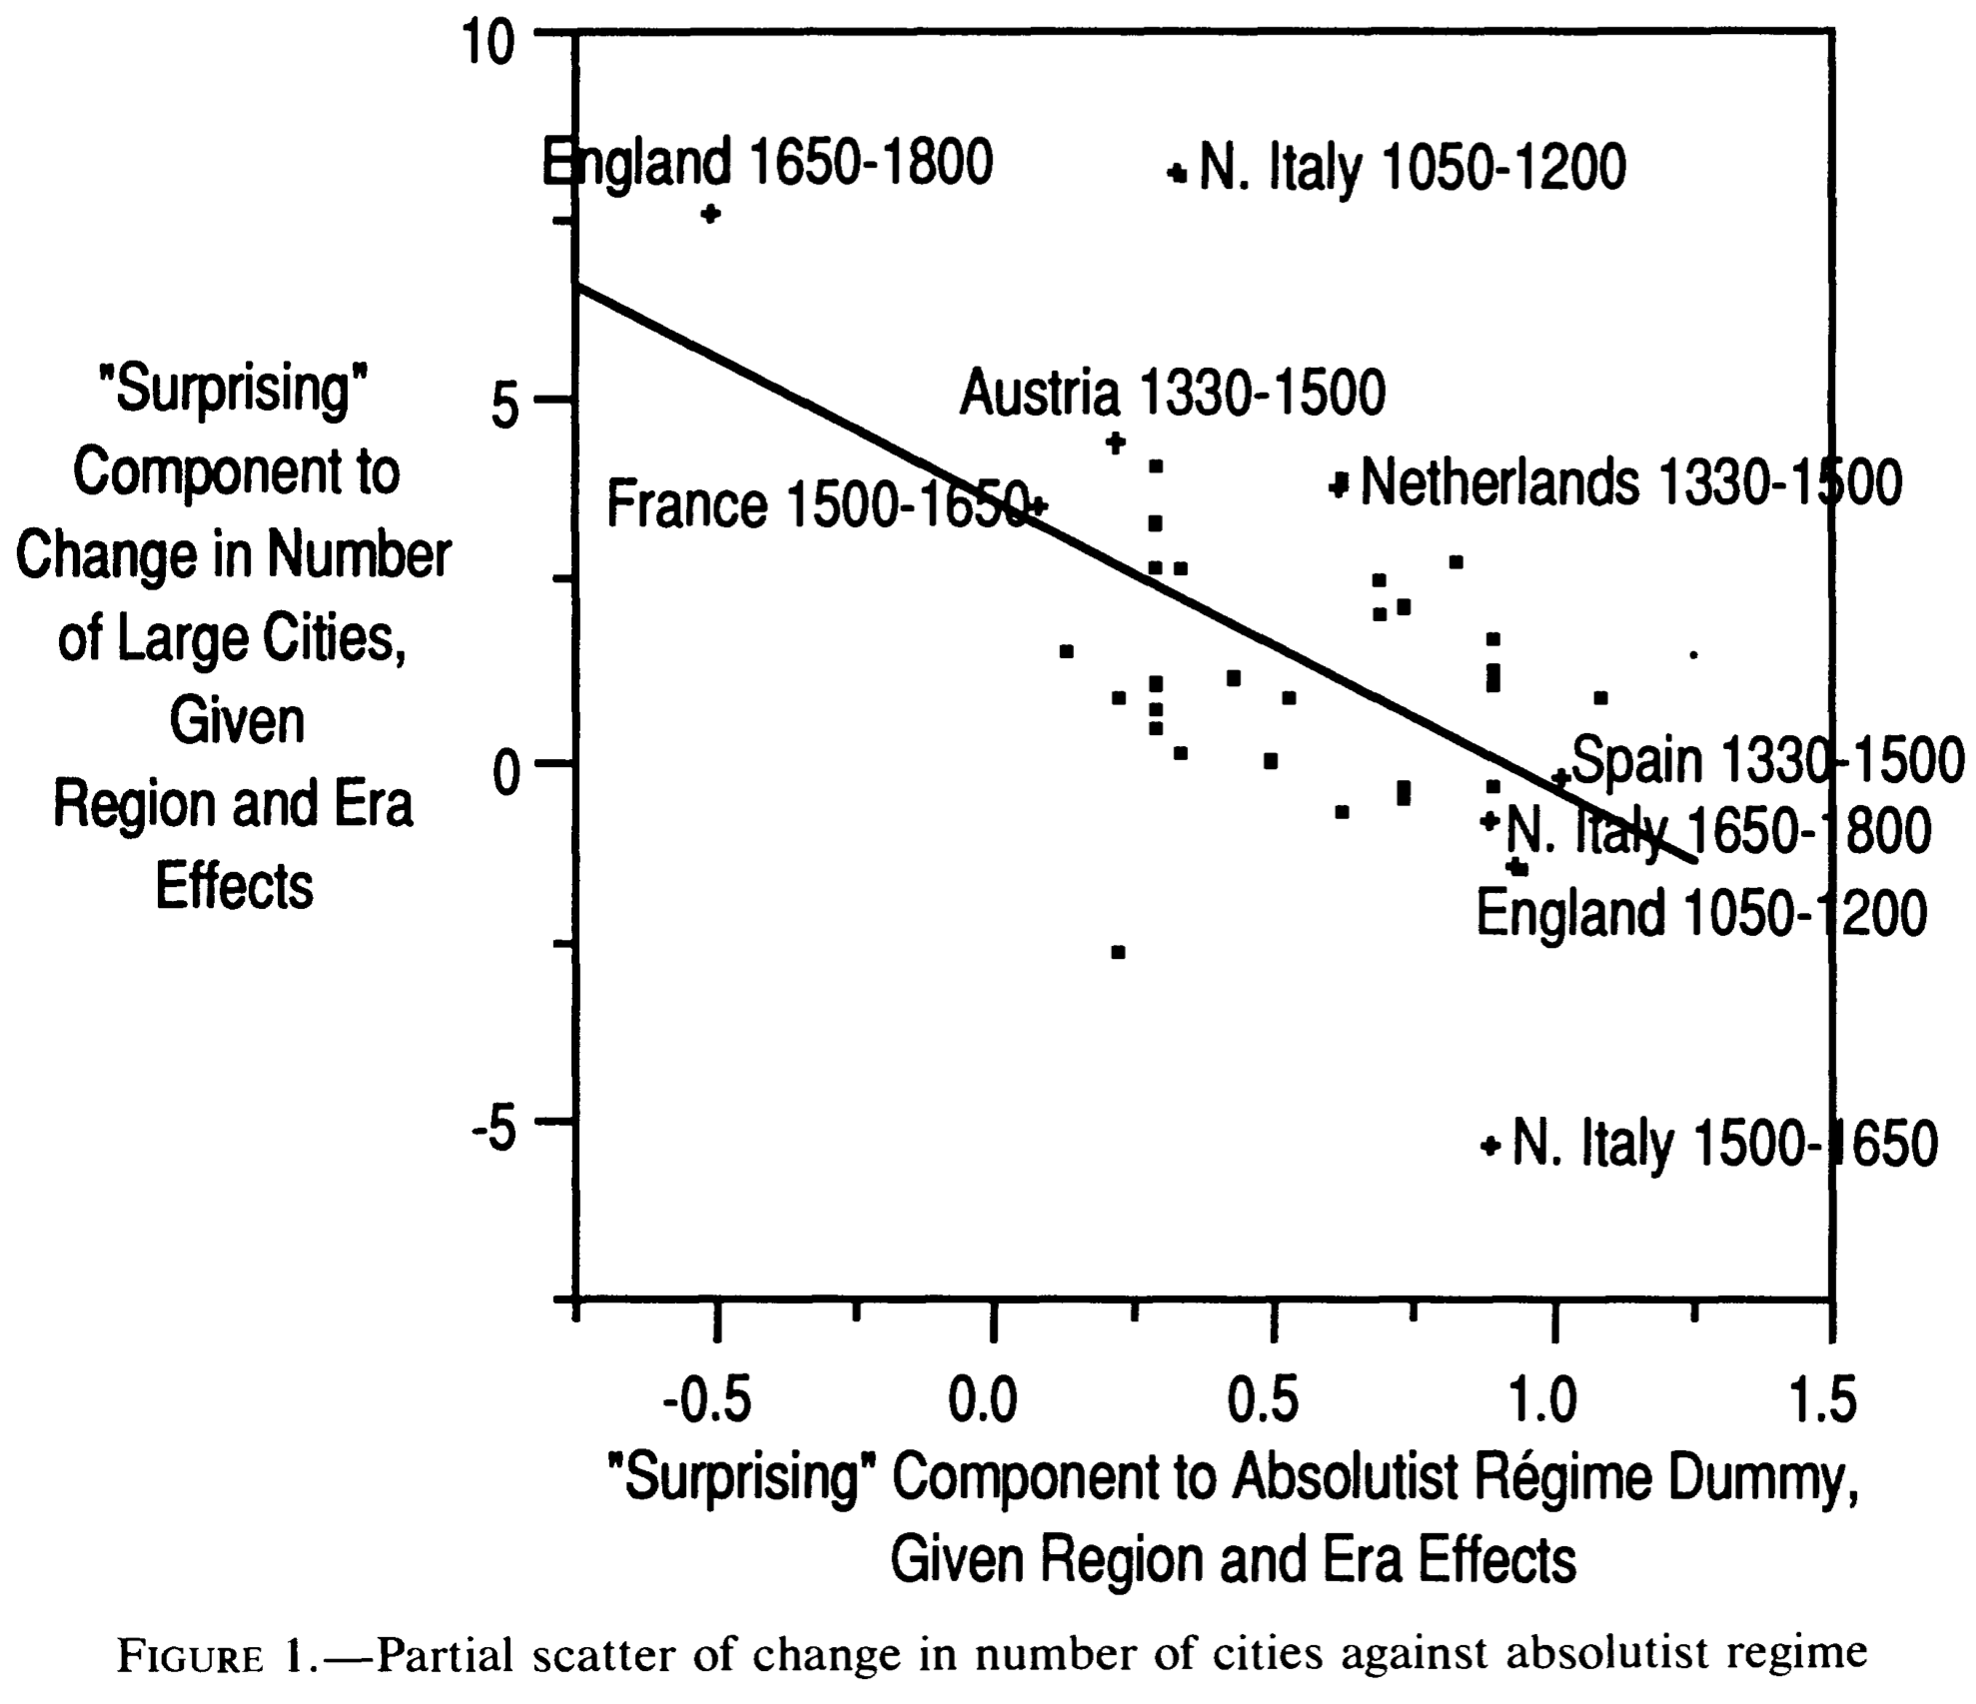
Is Malthus Right? II
At the macro level, yes; but there are lots of interesting meso- and small-scale puzzles:
In addition, measures of good government, such as proxies for constraints on the executive, are correlated with urbanization in this period.
For example, DeLong and Shleifer (1993) showed there was a strong correlation between form of government and urbanization in the pre-modern world
Charles Wilson (1967): Trade, Society, and the State: "The two areas which in 1500 represented the richest and most advanced concentrations of trade, industry and wealth were the quadrilateral formed by the Italian cities Milan, Venice, Florence and Genoa; and the strip of the Netherlands that ran from Ypres north-east past Ghent and Bruges up to Antwerp. It was not merely coincidence that these were the areas where the tradesmen of the cities had been most successful in emancipating themselves from feudal interference and in keeping at bay the newer threat of more centralized political control offered by the new monarchies. In the fleeting intervals between the storms of politics and war, men here glimpsed the material advance that was possible when tradesmen were left in peace unflattered by the attentions of strategists who regarded their activities as the sinews of war…”
Slide taken from Melissa Dell

Slide 11
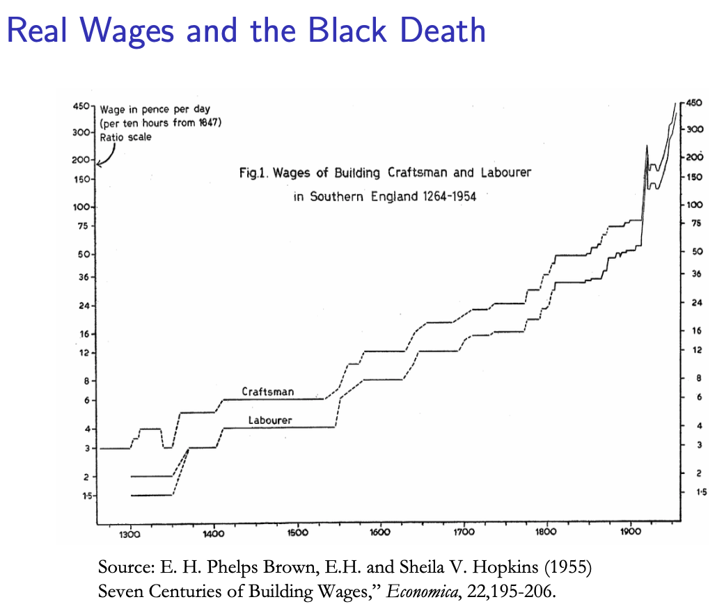
Malthus and the Black Death
The 1346-48 Bubonic Plague killed off about 1/3 of the population of Europe
A basic premise of the Malthusian model is that when population falls, incomes should rise. Is that true?
One important event used to support the Malthusian model is the Black Death.
As the data for Western Europe shows, after the population collapse, real wages eventually increased. However, the reality is more complex than is conveyed by the Malthusian model.
After the Black Death, the government of Edward III tried to stop wages from rising by passing the Statute of Labourers.
They were only partially able to enforce this, however, and after the Peasants Revolt of 1381, they mostly gave up.
Slide taken from Melissa Dell

Slide 12
The Statute of Laborers
Rosemary Horrox ed. (1994) The Black Death, Manchester University Press:
Because a great part of the people and especially of the, workmen and servants has now died in that pestilence, some, seeing the straights of the masters and the scarcity of servants, are not willing to serve unless they receive excessive wages ... We, considering the grave inconveniences which might come from the lack especially of ploughmen and such labourers, have ... seen fit to ordain: that every man and woman of our kingdom of England ... shall be bound to serve him who has seen fit so to seek after him; and he shall take only the wages liveries, meed or salary which, in the places where he sought to serve, were accustomed to be paid in the twentieth year of our reign of England, or the five or six common years next preceding [1347]…
“Enticement”
And if a reaper or mower, or other workman or servant, of whatever standing or condition he be, who is retained in the service of any one, do depart from the said service before the end of the term agreed, without permission or reasonable cause, he shall undergo the penalty of imprisonment, and let no one ... moreover, pay or permit to be paid to any one more wages, livery, meed or salary than was customary as has been said…
Slide taken from Melissa Dell

Slide 13
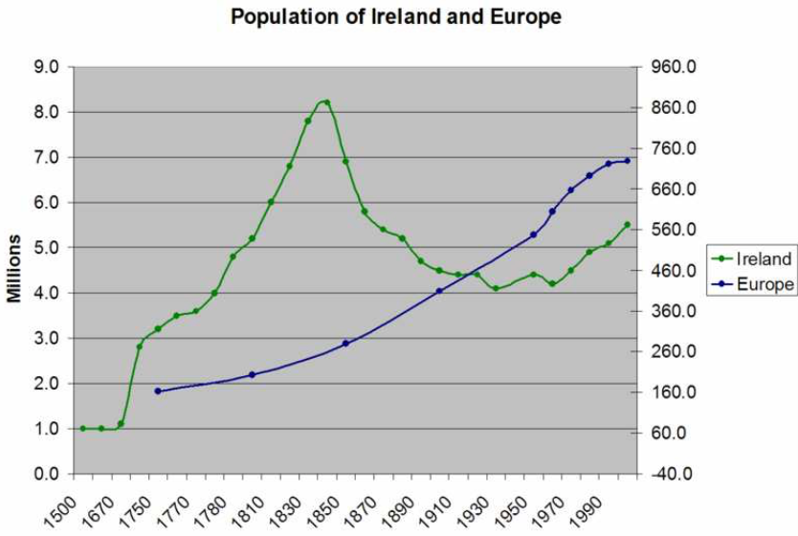
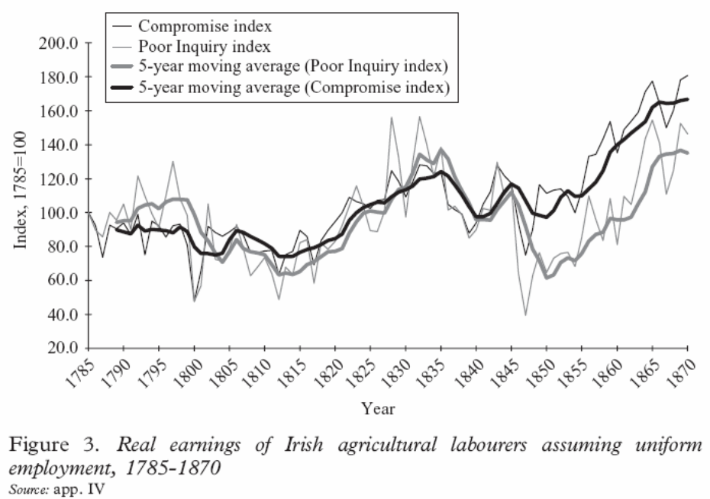
Do Real Wages Increase After Negative Population Shocks?
Not always:
After the conquest of Mexico the indigenous population fell by around 90%.
This ought to have led to a huge increase in real wages, but it did not.
But sometimes:
After the Great Potato Famine in Ireland between 1846 and 1849, when probably 20% of the population died or left, real wages increased substantially afterwards
Slide taken from Melissa Dell

Slide 14
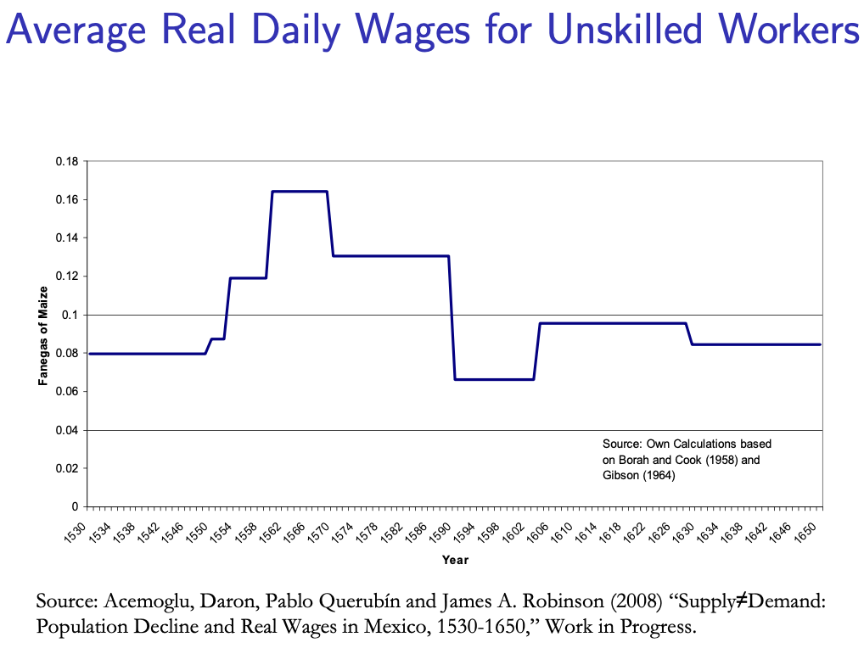
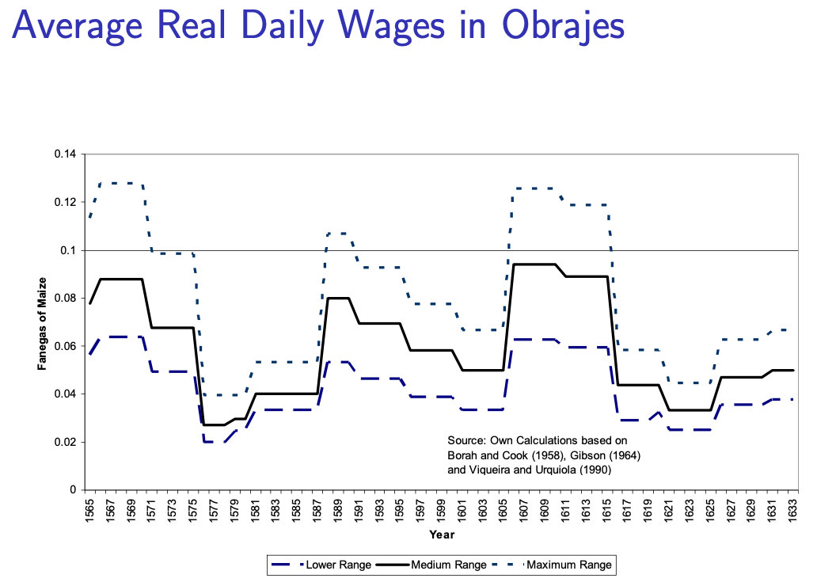
Why Didn’t Real Wages Rise in Post-Conquest Mexico?
“Institutions”:
Data are from the Repartimiento, which was a system of central labor allocation. Spaniards who wanted labor had to petition the Viceroy who would allocate Amerindian workers and determine the nominal wage they would be paid. There are also data from labor contracts in textile obrajes.
In both cases, coercion was used to repress wages and at least in the case of the repartimiento, the centralized nature of the system possibly stopped the type of ‘enticement’ which undermined the intent of the Statute of Labourers in England.
Meanwhile in South America, a massive forced labor system called the mita system was instituted.
The relative advantage of the Spanish state was higher than that of the English state in the 14th century.
Slide taken from Melissa Dell

Slide 15
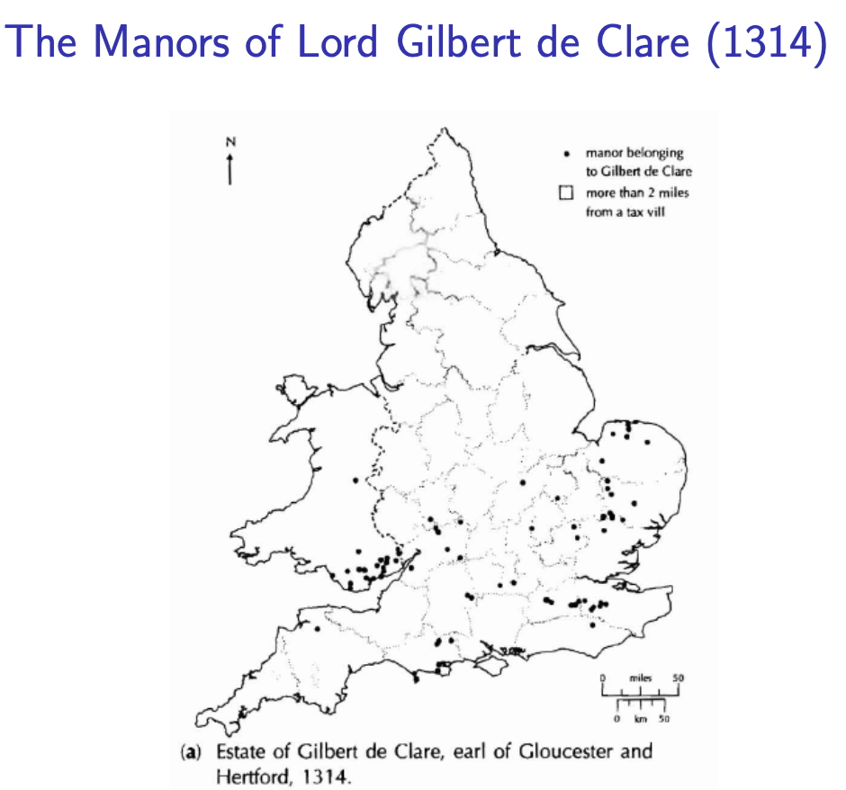
Feudal Power and Lordly Competition in England After the Black Death
What kept English lords from being able to keep a lid on wages post-1348?
What was it that allowed the Spanish settlers in Mexico to keep wages so low, when in England after the Black Death the state had been incapable of enforcing the Statue of Laborers and stopping wages from rising?
The economic historian Bruce Campbell has proposed that this may have been because of the differential organization of landholdings in Britain, which increased competition between landowners for workers after the Black Death.
After invading England, William the Conqueror rewarded his army by providing them with feudal landholdings.
In an effort to prevent these nobles from becoming powerful regional warlords who could challenge the king’s power, each noble received landholdings scattered across the country
(The exception was along the Scottish and Welsh borders), where nobles were given large plots for defensive purposes
This division of landholdings meant that in a given region, there were many landholders in close proximity.
This created intense competitive pressures for labor, particularly in the wake of the Black Death
This contrasts to Mexico, where conquistadors were granted vast contiguous tracks of land called encomiendas
Slide taken from Melissa Dell

Slide 16
Malthus: Summing Up
On the broadest scale only:
The simple Malthusian model may indeed capture some realities.
If labor markets are competitive, population growth may indeed induce a decline in wages.
Or if there is a fixed amount of land and few opportunities for labor intensive cultivation systems, a population increase may lead to a decline in output per worker.
However, the reality is typically much more messy.
How wages respond to changes in income will depend on institutions.
Thus the overwhelming likelihood that institutional or cultural factors also shaped pre-modern growth
It was not simply being dictated by the Malthusian relationship between births, deaths, and income.
Slide taken from Melissa Dell

Slide 17
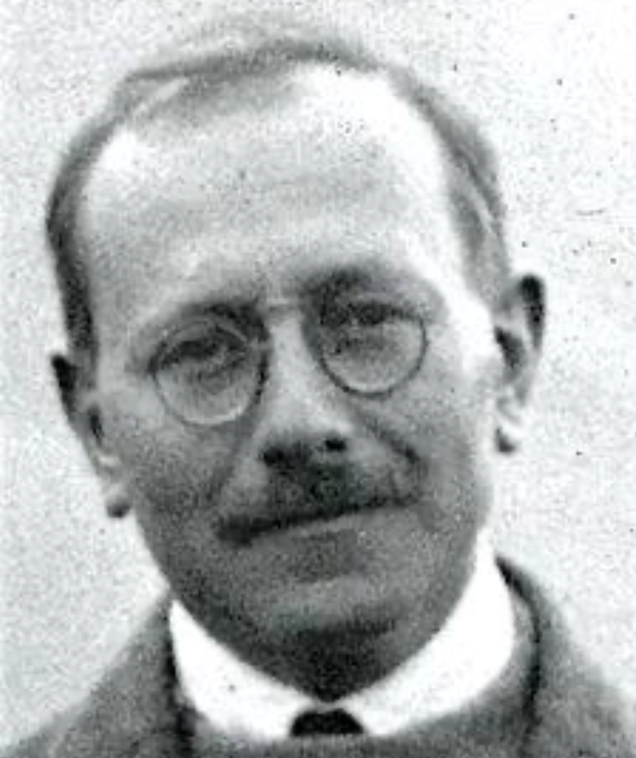
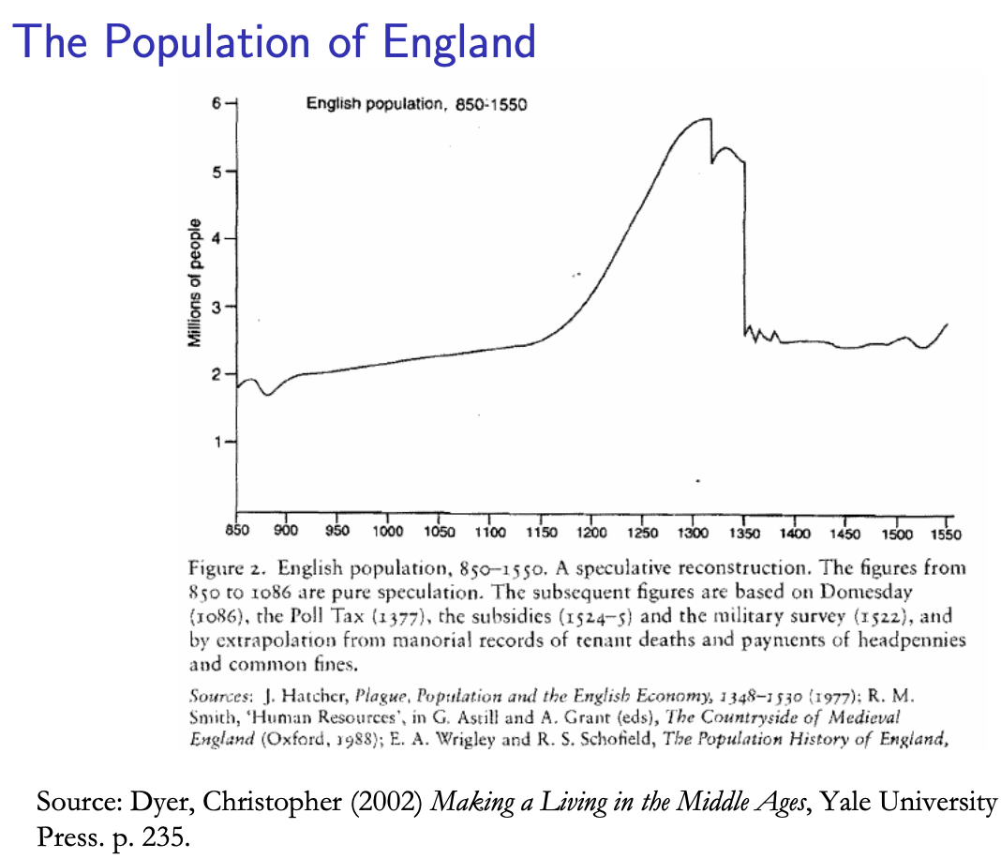
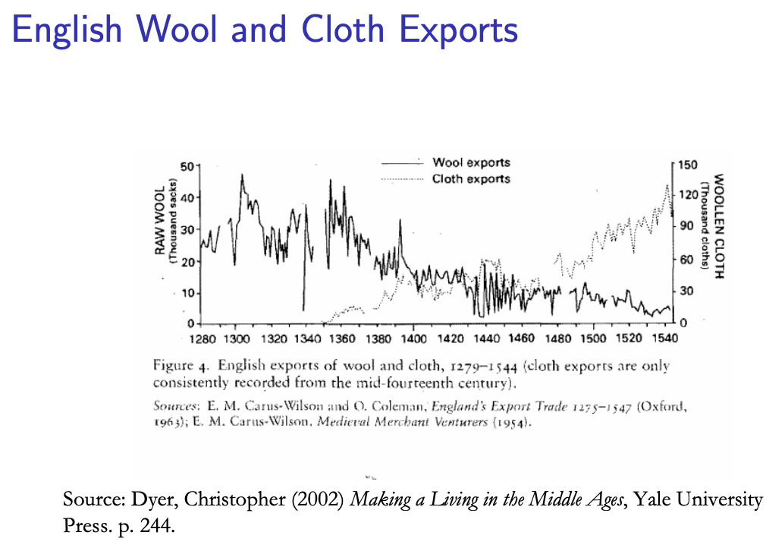
Class and Conflict at the End of the Middle Ages
What was “feudalism” and how did it end?
Marc Bloch’s definitions:
A subject peasantry
Widespread use of the service tenement (i.e., the fief) instead of a salary (or of private property plus taxation and then purchase)
The supremacy of a caste of specialized warriors
Ties of obedience and protection which bind man to man
Within the warrior class, these ties assume the distinctive form called vassalage
Fragmentation of authority
Disorder and private war
But also, other forms of association, family, and state surviving…
By the late Middle Ages feudalism was a stable system
Trade and population expanded
What data we have shows the number and size of cities increasing
Slide taken from Melissa Dell

Slide 18
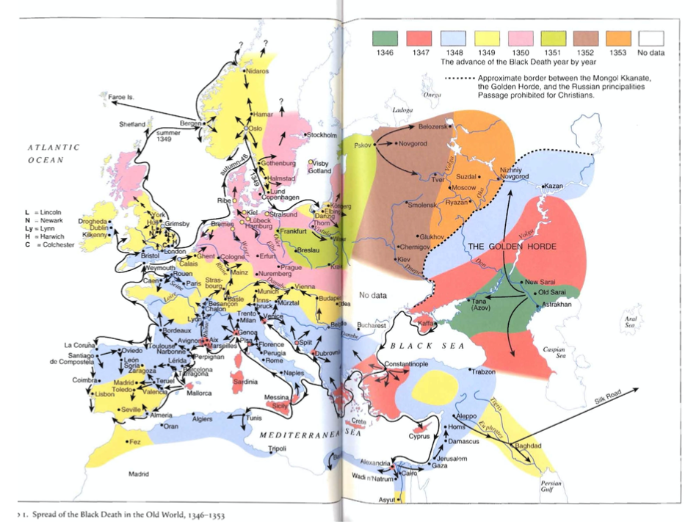
The Black Death and the Collapse of the FMP
The Black Death in Florence: Giovanni Boccaccio:
In the face of its onrush, all the wisdom and ingenuity of man were unavailing .. the plague began, in a terrifying and extraordinary manner, to make its disastrous effects apparent.
It did not take the form it had assumed in the East, where if anyone bled from the nose it was an obvious portent of certain death. On the contrary, its earliest symptom . . . was the appearance of certain swellings in the groin or armpit, some of which were egg-shaped whilst others were roughly the size of a common apple.…
Later on the symptoms of the disease changed, and many people began to find dark blotches and bruises on their arms, thighs and other parts of their bodies ...
Against these maladies .. all the advice of physicians and all the power of medicine were profitless and unavailing .. and in most cases death occurred within three days from the appearance of the symptoms we have described…
Slide taken from Melissa Dell

Slide 19
The Black Death and the Collapse of the FMP
1/3 of Europe’s population dropped dead over 1346-8:
Some time around the middle of 1346 the bubonic plague reached the city of Tana at the mouth of the River Don on the Black Sea. It traveled from China brought by traders along the Silk Road.
The plague was transmitted by fleas that lived on rats.
Tana was a port and the rats were soon spreading the fleas and devastation around the Mediterranean through Genoese ships.
By early 1347 it had reached Constantinople.
In the spring of 1348 it spread through France and North Africa and up the boot of Italy.
Acemoglu and Robinson argue that in Western Europe, feudalism and the Medieval Boom collapsed with the Black Death, ultimately leading to a new set of institutions that sustained economic growth.
The collapse of institutions in Western Europe came with a great deal of disorganization and chaos - for instance the 100 Years War between 1337 and 1453 between England and France.
We saw that Jongmans’ idea about the collapse of the Roman Empire was that the Antonine Plague tipped institutions in a direction that emphasized labor coercion. The Black Death did that in Eastern Europe. In Western Europe, it did not. However, a new political model needed to develop before the economic benefits of the decline of feudalism could be experienced
Slide taken from Melissa Dell

Slide 20
Eastern Europe and the “Second Serfdom”
Eastern Europe after 1348 is very different:
The plague seems to have hit most of Europe, and the percentage of people killed was similar across space.
After the plague, landlords in Eastern Europe started to take over large tracts of land and expand their holdings, which were already larger than those in Western Europe.
Towns were weaker and less populous and rather than becoming freer, workers began to see their already existing freedoms encroached on: the Domar hypothesis at work.
This contrasts with the English case, and with Western Europe more generally.
This phenomenon is known as the Second Serfdom, to distinguish it from the original serfdom which had happened in the early Middle Ages.
The effects became especially pronounced after 1500, when Western Europe began to demand the agricultural goods which the East produced such as wheat, rye and livestock.
80 percent of the imports of rye into Amsterdam came east from the Elbe, Vistula and Oder river valleys. Soon half of the Netherlands’ booming trade was with Eastern Europe.
Eastern landlords ratcheted up their control over the labor force to expand their production.
The historical literature emphasizes that the Second Serfdom was distinct and more intense than the original
Lords increased the taxes they levied on their tenants. In Mecklenberg in Eastern Germany in 1500, peasants owed only a few days unpaid labor services a year to landowners. By 1550 this was one day a week and by 1600 three days per week. Workers’ children had to work for the lord for free for several years.
In Hungary, landlords legislated one day a week of unpaid labor services for each worker. In 1550 this was raised to 2 days per week. By the end of the century it was 3 days. Serfs subject to these rules made up 90% of the rural population by this time.
Slide taken from Melissa Dell

Slide 21
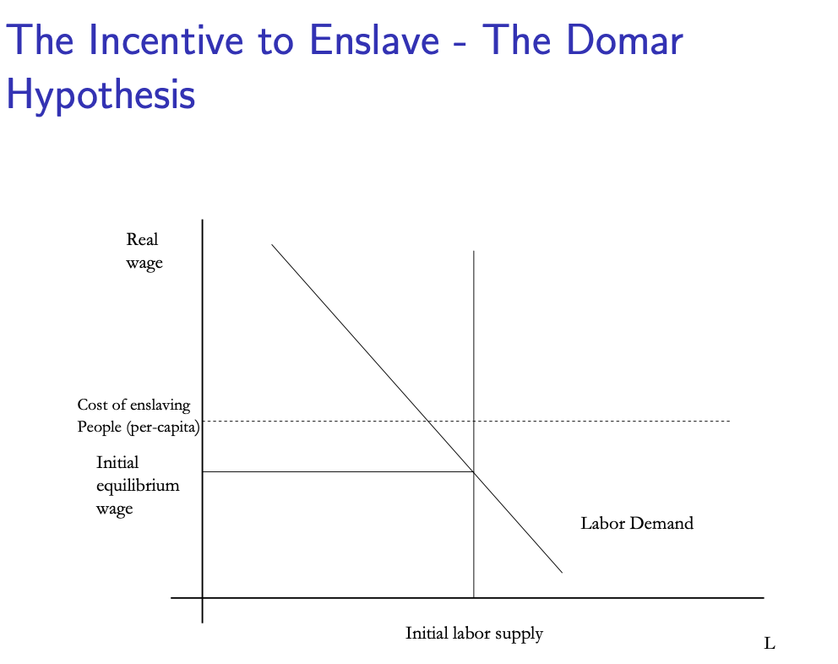
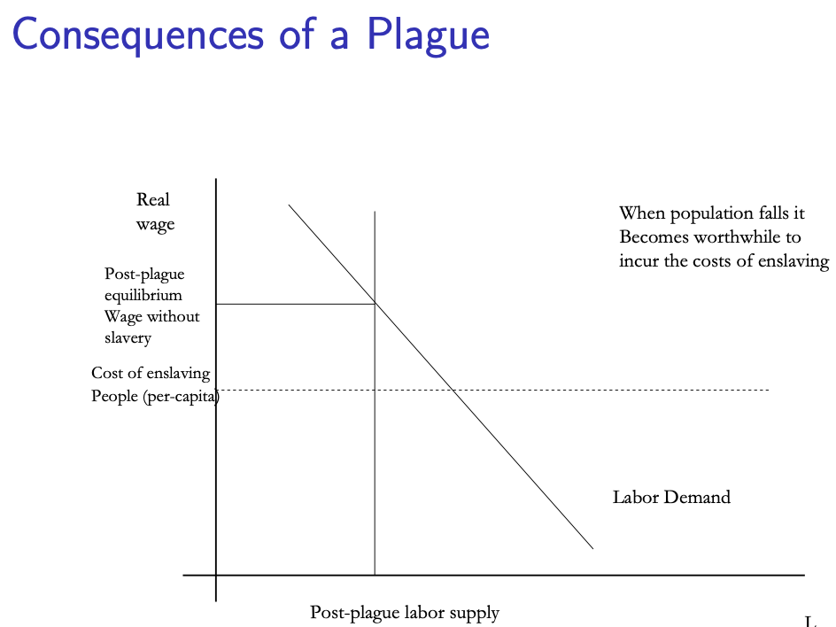
Domar’s Analysis and the Second Serfdom
Jongmans explicitly compares the decline of Rome to the Second Serfdom
His argument is that the most important potential impact of population collapse is on institutions. His argument is that the Antonine plague pushed economic institutions into a much more extractive mode and this is why the Empire collapsed.
This is outside the scope of the Domar model. Clearly, the model needs not just to be amended by introducing power but also the fact that when the labor market ‘power’ of workers is high this can not only avoid slavery or serfdom but can induce other institutional changes in society.
Slide taken from Melissa Dell

Slide 22
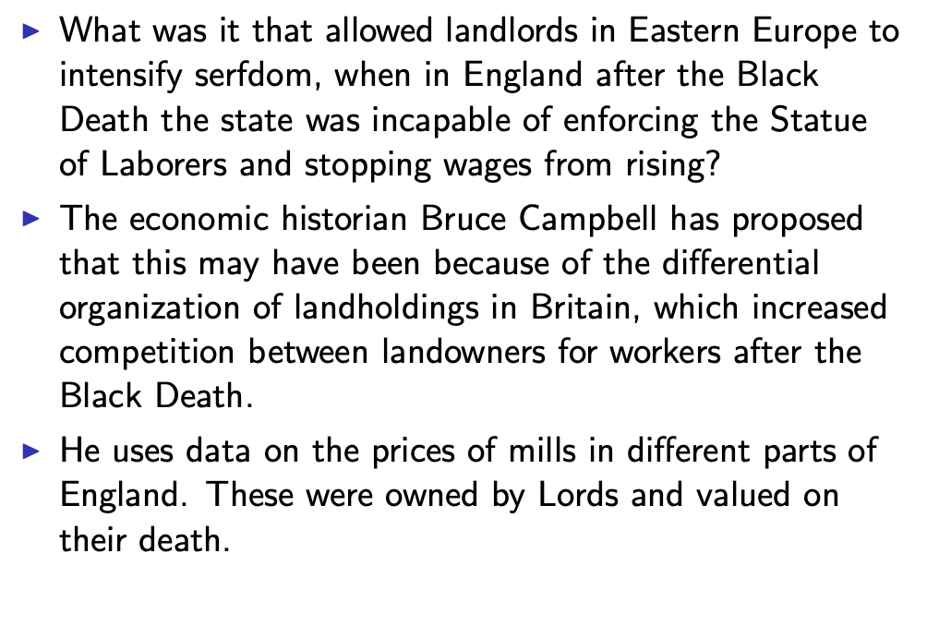
The Emergence from the Middle Ages Begins with the Black Death
Slide taken from Melissa Dell

Slide 23
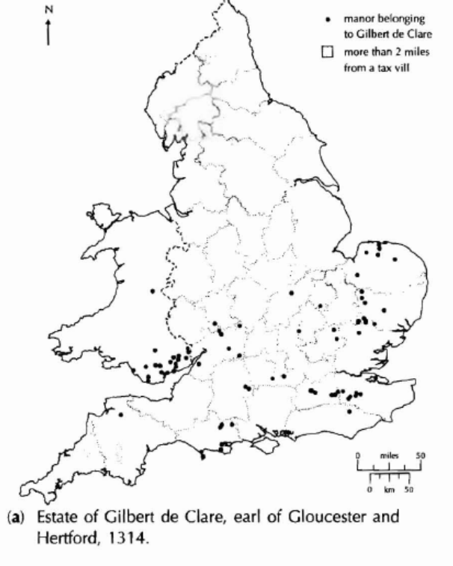
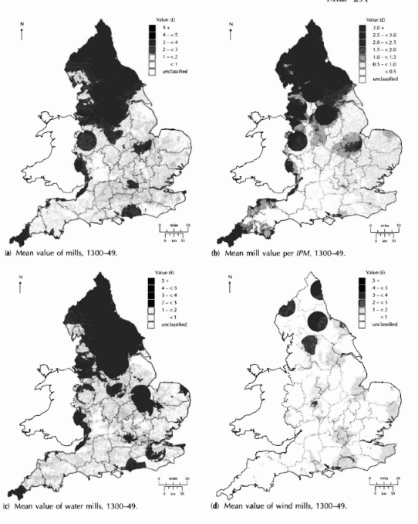
The Manors in 1314 of Gilbert de Clare, and the Mills of England
Slide taken from Melissa Dell

Slide 24
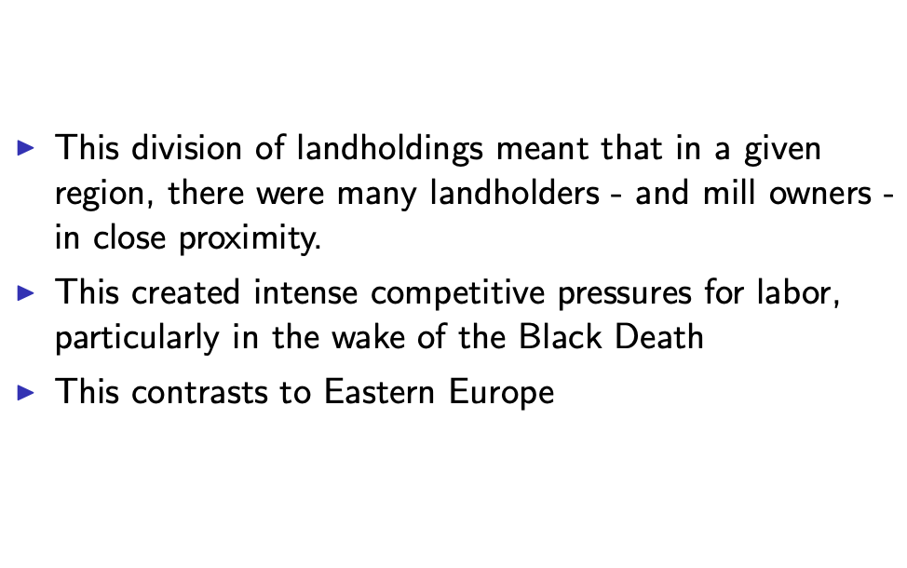
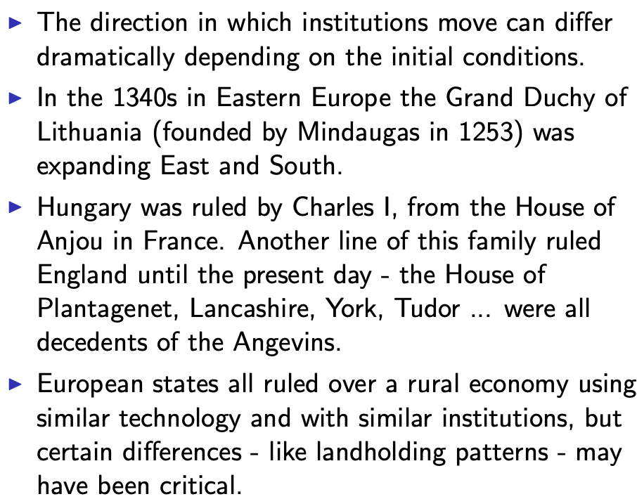
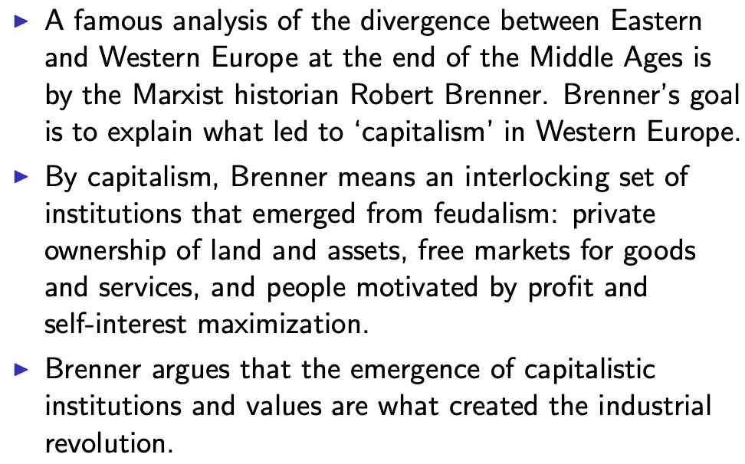
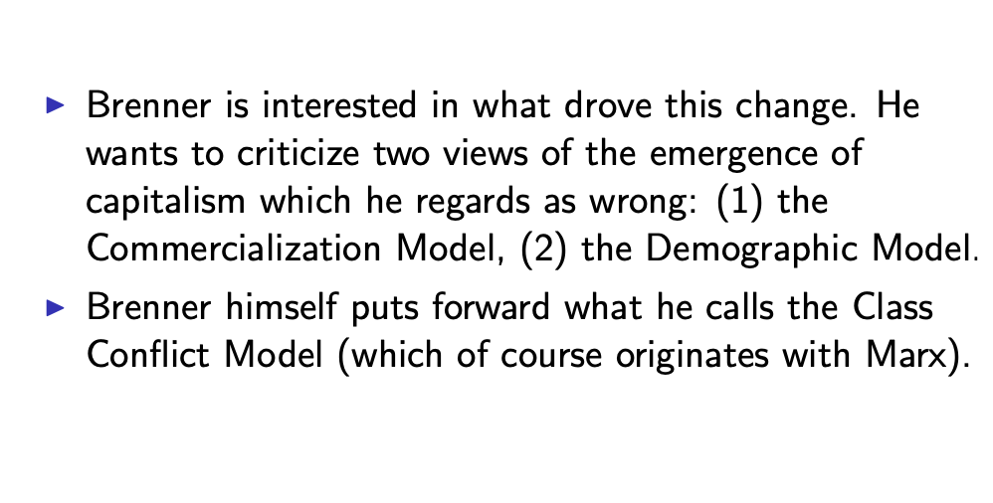
Different Starting Points and Different Plague Consequences
Slide taken from Melissa Dell

Slide 25
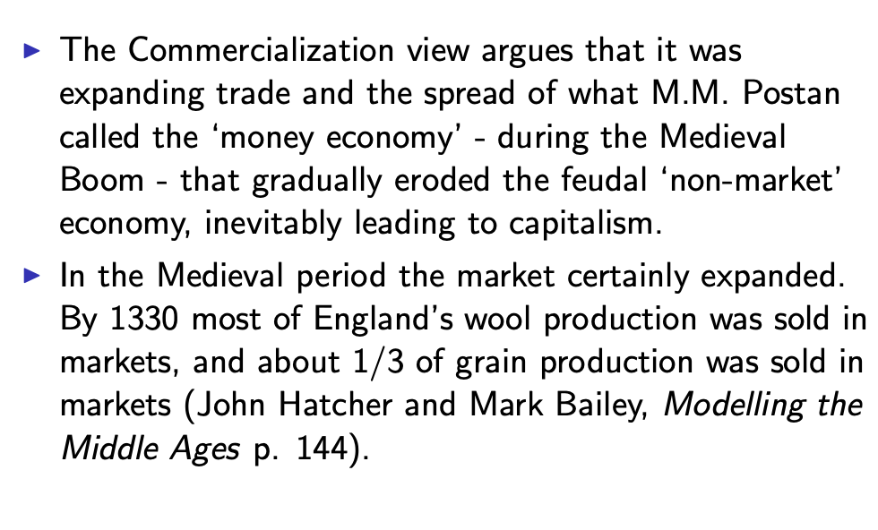
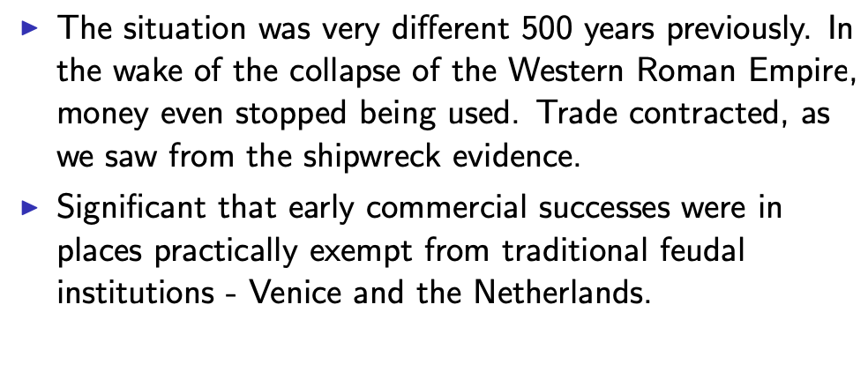
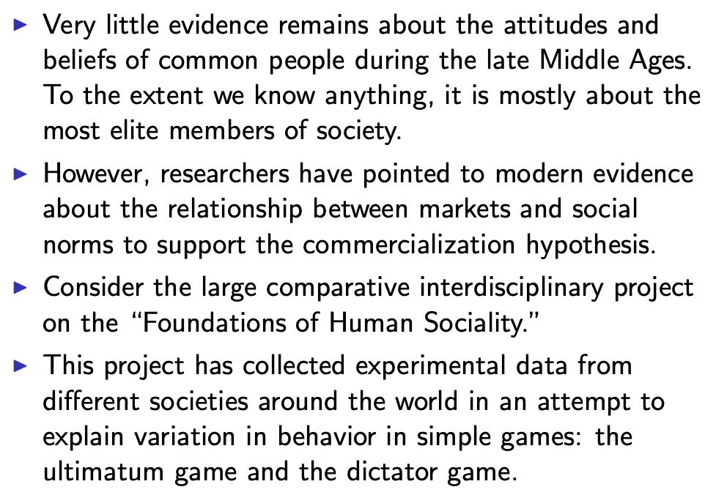
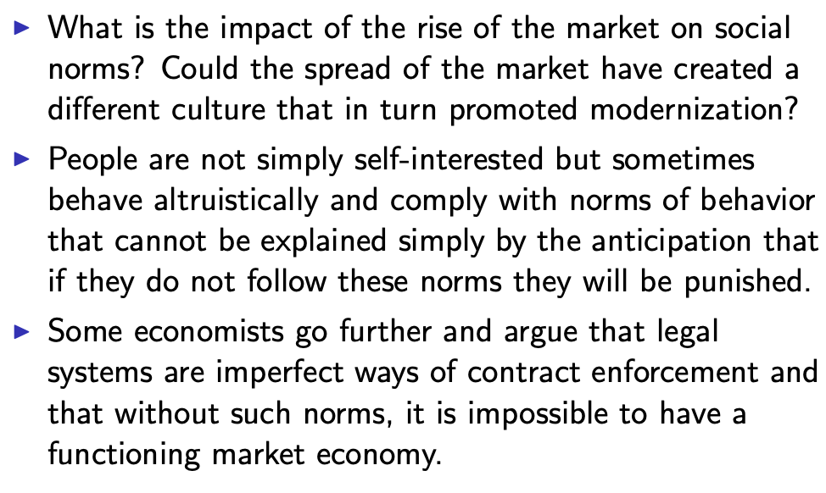
We See “Commercialization” and “Demography” and “Institutions” as Drivers of “Class Power”
Slide taken from Melissa Dell

Slide 26
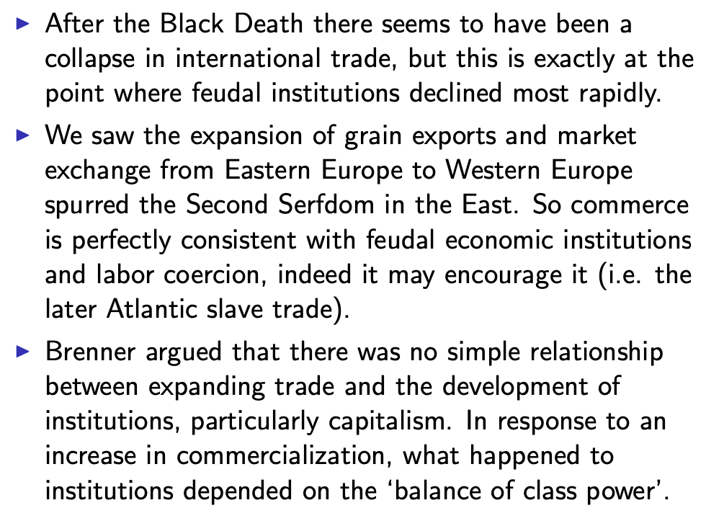
Brenner’s Attack on the Commercialization Model
Slide taken from Melissa Dell

Slide 27
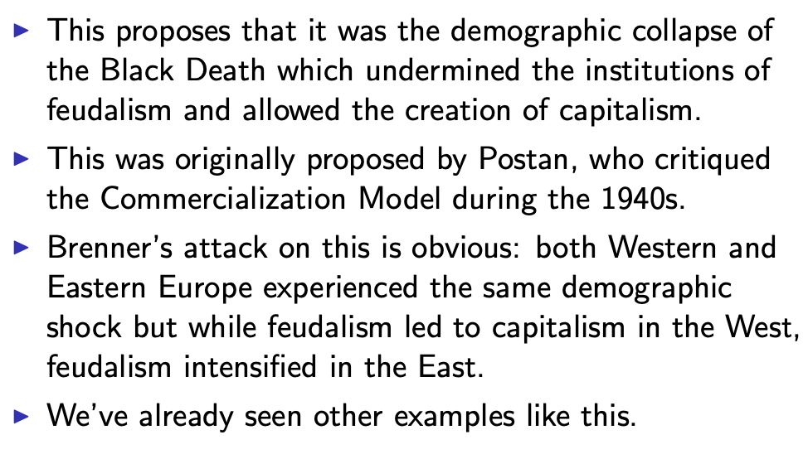
The Demographic Model
Slide taken from Melissa Dell

Slide 28
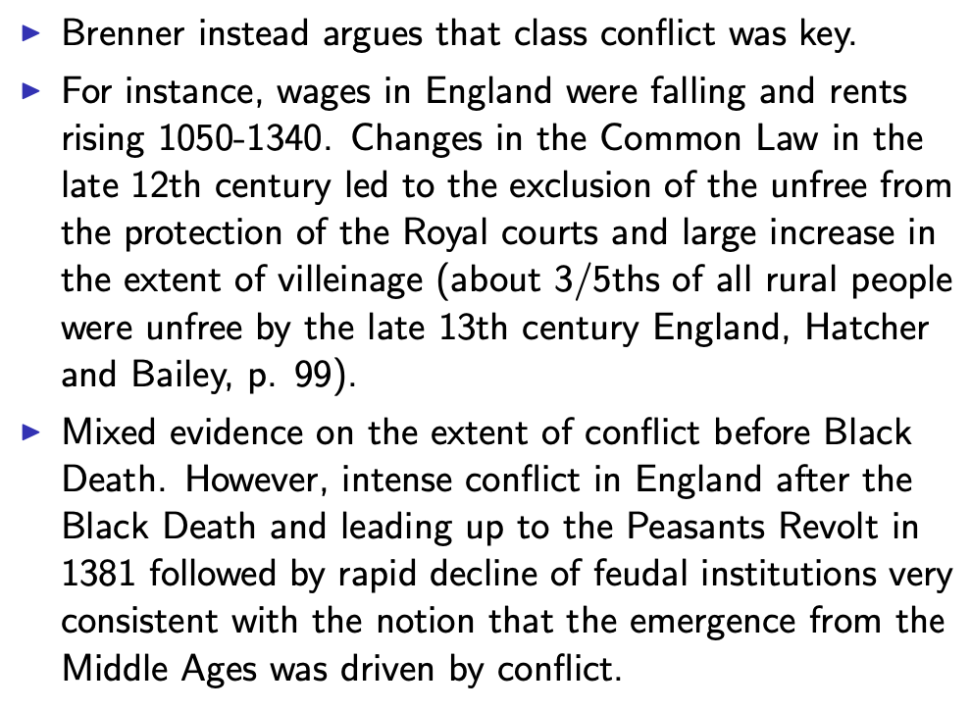
The Class-Conflict Model
Slide taken from Melissa Dell

Slide 29
A Four-Cornered Fight
Kings, Lords, Commons, & Peasants:
Class alliances, class power, and class conflict…
Plus ideological legitimations…
Friedrich Engels: “Exceptional periods, however, occur when the warring classes are so nearly equal in forces that the state power, as apparent mediator, acquires for the moment a certain independence in relation to both. This applies to the absolute monarchy of the seventeenth and eighteenth centuries, which balances the nobility and the bourgeoisie against one another; and to the Bonapartism of the First and particularly of the Second French Empire, which played off the proletariat against the bourgeoisie and the bourgeoisie against the proletariat. The latest achievement in this line, in which ruler and ruled look equally comic, is the new German Empire of the Bismarckian nation; here the capitalists and the workers are balanced against one another and both of them fleeced for the benefit of the decayed Prussian cabbage Junker-squires…”
This is not just in exceptional periods…
The relative autonomy of the state is the rule, not the exception…

Slide 30
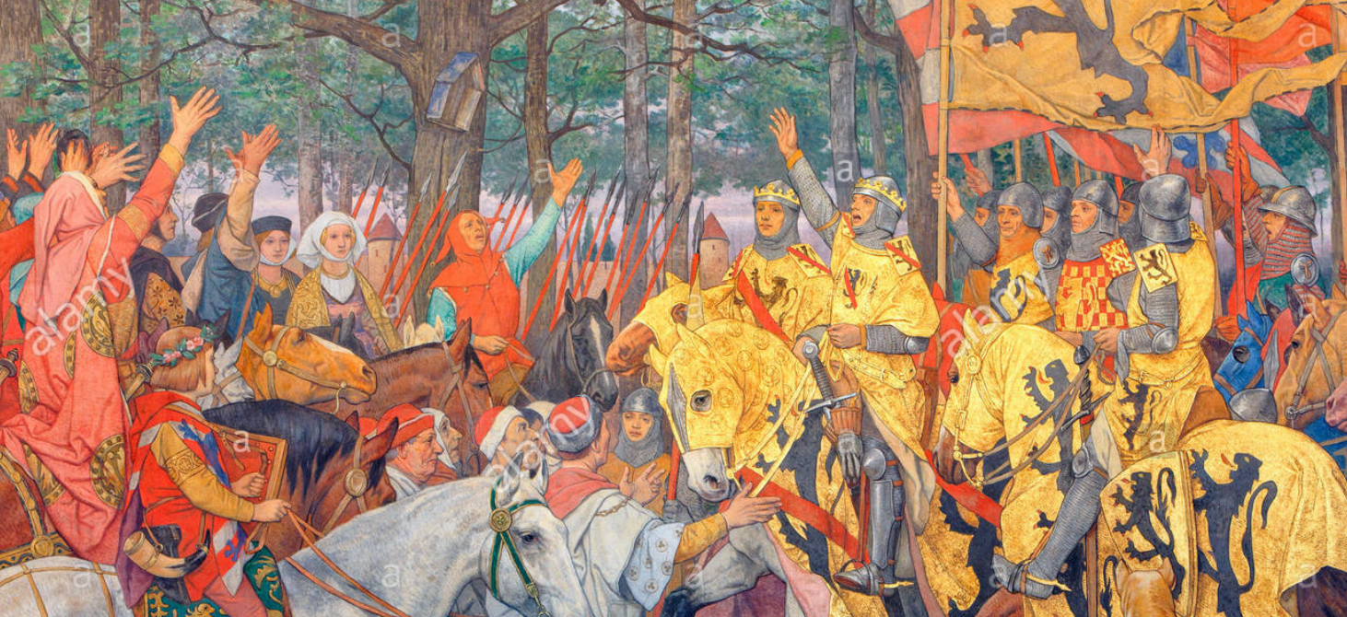
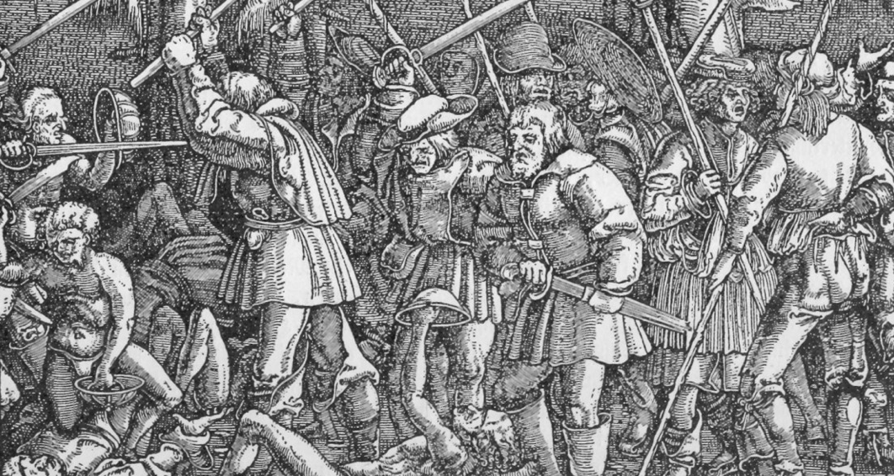
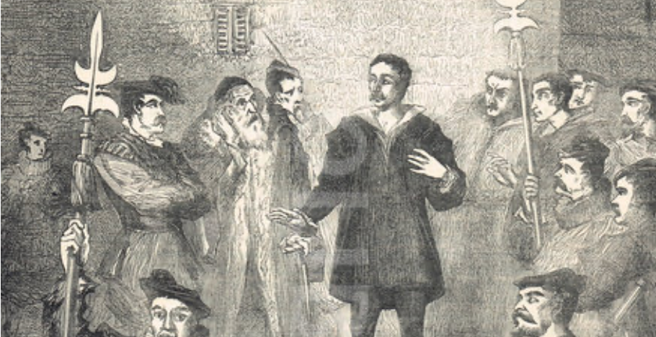
Big Ideas: Lecture 5: Malthusian Agrarian Economies
Takeaways from this lecture:
Malthus works in the large and in the long run:
Populations expand at an average rate of 0.07% per year from -8000 to 1500
Population in 1500 250x what it had been in -8000
Typical living standards do not (by much)
But there is lots more going on:
Differential rates of exploitation
When something—the labor of peasants, for example—becomes very valuable, you can react in either of two ways:
You can offer to trade more in exchange for it
You can spend resources to control it
And those attempts to control can be successful or unsuccessful
Trade and law and imperial peace…
Luxuries…
Sociology that determines what the zpg level of necessities consumption is…

Slide 31
Catch Our Breath…
Ask a couple of questions?
Make a couple of comments?
Any more readings to recommend?

Slide 32

Review: Long-Run Patterns: Global h, g, & n

Slide 33

Long-Run Patterns: “Western” h, g & n
Where does the “ρ” come from?
“Ghost acreage”—conquest and resource utilization (sugar islands, timberlands, cottonlands, etc.)
Cultural expansion—Australia, Canada, New Zealand, & U.S.; Spain & Italy & Scandinavia; plus Japan, Korea, Taiwan, Hong Kong, & Singapore

Slide 34

One Figure: A Great Divergence
10:20
From 1800 to 2018:
The dots start with a 3-1 spread in incomes and a 10-year spread in life expectancy.
All the arrows go up.
Some arrows—mostly those already to the right—go right fast.
Other arrows go right slowly.

Slide 35

China and India and America, 1800-1975
From 1800 to 1975:
Measured living standards and productivity levels improve fourteen-fold in the United States…
…& less than 30% in China & India…
…in spite of economic, transport, and cultural globalization…
This is crazy!
A “great divergence”
Not only were China & India relatively poor in 1800, they fell further behind thereafter

Slide 36

China and India and America, 1975–2018
From 1975-2018:
Measured living standards and productivity levels…
…54.9/25.9 = 2.12 in America…
…16.0/0.9 = 17.8 in China…
…6.9/1.2 = 5.8 in India…

Slide 37






Review: Solow Model Basics
Lecture Notes: <https://www.bradford-delong.com/2020/01/lecture-notes-the-solow-growth-model-the-history-of-economic-growth-econ-135.html>

Slide 38

Solving the Model

Slide 39

Along the Balanced-Growth Path
Everything except κ—which is constant—grows at a constant proportional rate: either n, or g, or n+g;
Labor force L grows at n
Income per worker y and the efficiency of labor E grow at g
Total income Y and the capital stock K grow at n+g

Slide 40
Review: Solow-Malthus Model Basics
How do we make sense of the fact that people were ingenious and inventive back before 1500, and yet standards of living did not increase?
Although population did increase—slowly
Other parts of the model
Balanced-growth equilibrium
Convergence to equilibrium
Lecture notes: <https://nbviewer.jupyter.org/github/braddelong/long-form-drafts/blob/master/solow-model-5-pre-industrial.ipynb>
datahub: <http://datahub.berkeley.edu/user-redirect/interact?account=braddelong&repo=long-form-drafts&branch=master&path=solow-model-5-pre-industrial.ipynb>

Slide 41
Understanding the Solow-Malthus Equilibrium: Population and Labor Force
Notes:

Slide 42
Understanding the Solow-Mathus Equilibrium: Prosperity
Notes:

Slide 43

Steady-State and Along the Transition Path
The fall of an empire:
<https://nbviewer.jupyter.org/github/braddelong/LS2019/blob/master/2019-10-14-Ancient_Economies.ipynb>
A decline in inequality, taste for luxuries, and taste for urban living: Δφ = -0.25
A decline in law-and-order that produces a sharp fall in the savings rate: Δs = -0.10

Slide 44
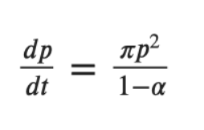
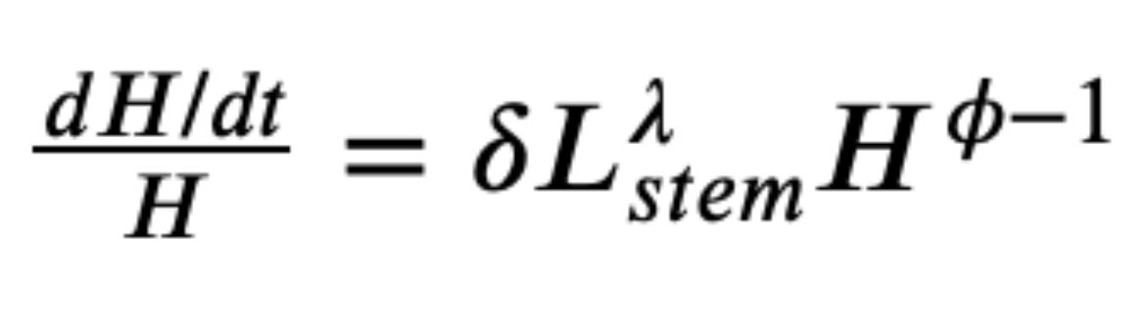
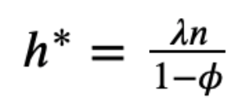
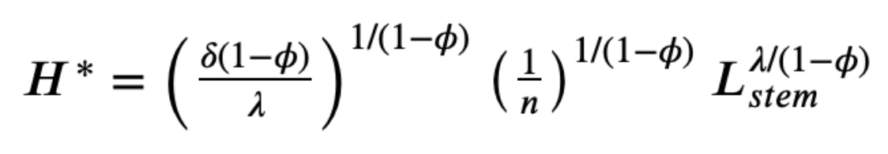
Review: Determinants of Technological and Organizational Progress
How do we make sense of the fact that technological and organizational progress was so slow back then and is so (relatively) rapid now?
Two heads are (almost) better than one
But that does not quite work
Add in additional drag from first picking low-hanging fruit
What causes the increase in Lstem?
What institutions make it profitable for nstem to be higher?
Plus:
Learning by doing
Productivity through embodiment
Technology transfer through contact

